Slide 1

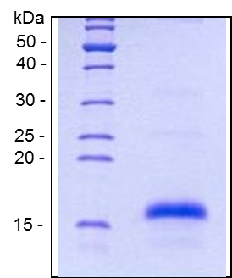
ReliaTech GmbH
Recombinant Orf virus VEGF-E
(Cat #300-044S / -044)
Fig. 1: SDS-PAGE analysis of recombinant Orf virus VEGF-E produced in E.coli. Sample was loaded in 15% SDS-polyacrylamide gel under reducing conditions and stained with Coomassie blue.
http://www.reliatech.de / orders@reliatech.de

